Slide 1
INTRODUCTION TO WEB DEVELOPMENT - SESSION 1
Stojancho Jefremov - stojanco.jefremov@gmail.com

Slide 2

TIMELINE OF COMPUTERS AND THE WEB
FORTRAN - First compiled programming language
Concept of program invented
First design of high level language
C programming language
The term internet is born
First email is sent
1936
1946
1965
1969
1975
1980
1842
First programmable computer
1943
ENIAC I - Early general purpose computer
1962
Beginning of the internet
1969
First message sent through the internet
1973
First consumer computers
1976
C++ programming language
@SEDC 2018-2019
Notes:
First programmable computer - Z1
First design of high level language - Plankalkül
ENIAC I was huge
Beginning of the internet - Two computers communicated in MIT using packet switching technology
C - Systems programming language
First message was sent from a student at stanford research institute and it was LO, the student wanted to write LOGIN but the system crashed and LO was sent
Term internet is born in CERN, the name coming from huge network of networks ( inter- among many things net - network )
First email is sent by queen elizabeth
C++ - object and structured programming language

Slide 3
TIMELINE OF COMPUTERS AND THE WEB
Personal computer revolution
TCP/IP becomes standard
Microsoft Windows is released
HTML markup language
Microsoft creates Internet Explorer
The Internet explodes and takes over
1981
1984
1989
1991
1995
1998
1981
MS-DOS operating system
1982
Apple MAC is released
1985
First commercial internet provider
1990
Introduction to the World Wide Web
1995
JAVA and JavaScript are born
1996
Google search engine is born
@SEDC 2018-2019
Notes:
Personal computer revolution - IBM PC - Personal computer
TCP/IP becomes a standard protocol for the internet, and it is still used TODAY
Apple MAC computer is released, a more affordable home computer with GUI than Apple Lisa ( predecessor )
Microsoft windows 1.0
First commercial internet provider of dial-up internet called The World
HTML Markup language invented in CERN to structure web sites ( before website were only text based )
CERN introduces World wide web with its browser WorldWideWeb to the public

Slide 4
TIMELINE OF COMPUTERS AND THE WEB
MAC OSX and Windows XP emerge
Twitter goes online
Windows 7 operating system
IPad tablet computer is released
Facebook goes online
Apple watch introduced
2001
2005
2007
2009
2013
2018
2001
C# programming language
2004
Youtube goes online
2006
IPhone is introduced
2009
Bitcoin is released
2010
Voice recognition breakthrough
2015
WE ARE HERE
@SEDC 2018-2019

Slide 5
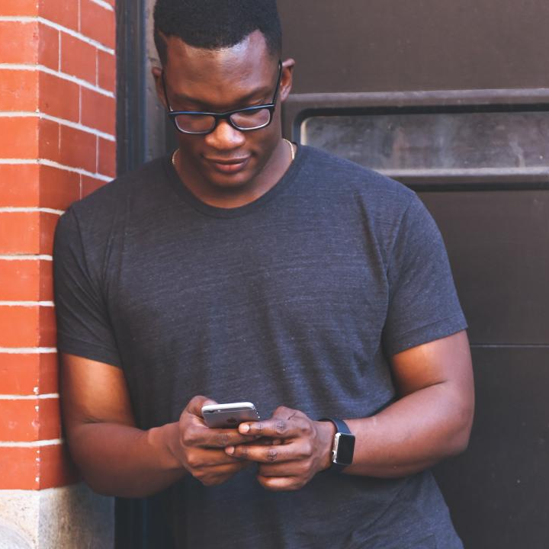
WHERE ARE WE NOW?
Technology is taking over every aspect of our lives
80% of the developed world uses the internet
The job market for developers is enormous
Strong and open developer community
@SEDC 2018-2019

Slide 6
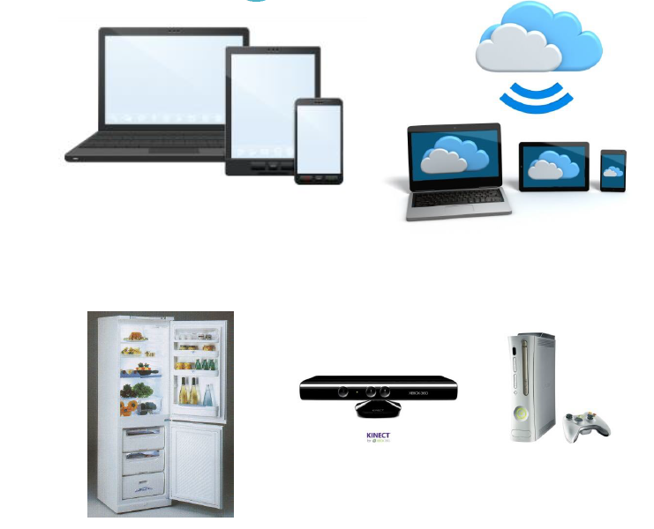
The current state of technologies
Devices-diversity
Mobile-first approach
Cloud technologies
Your fridge can get on Internet…
@SEDC 2018-2019

Slide 7
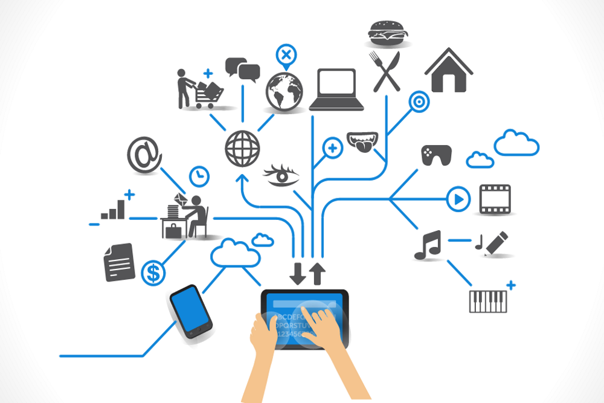
Internet of things
@SEDC 2018-2019
Notes:
First programmable computer - Z1
First design of high level language - Plankalkül
ENIAC I was huge
Beginning of the internet - Two computers communicated in MIT using packet switching technology
C - Systems programming language
First message was sent from a student at stanford research institute and it was LO, the student wanted to write LOGIN but the system crashed and LO was sent
Term internet is born in CERN, the name coming from huge network of networks ( inter- among many things net - network )
First email is sent by queen elizabeth
C++ - object and structured programming language

Slide 8

But what is the internet? How does it work?
@SEDC 2018-2019

Slide 9
WHAT THE INTERNET IS NOT
It is not ONE SINGLE thing that everyone access
It is not a huge company
We don’t open the internet by opening google
@SEDC 2018-2019

Slide 10
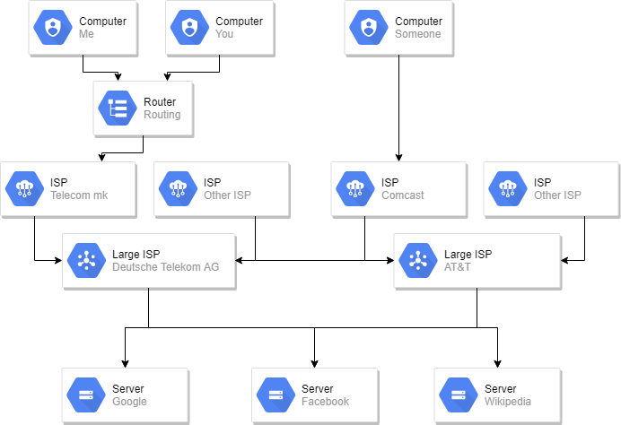
HOW THE INTERNET WORKS
@SEDC 2018-2019

Slide 11
The software industry today
Developing for different types of devices
Making devices work all together in a much better way
The focus now is on the client-side (front-end) -WEB is one of these clients
REST API communication has proven it’s way to the top of SOA Architectures

Slide 12
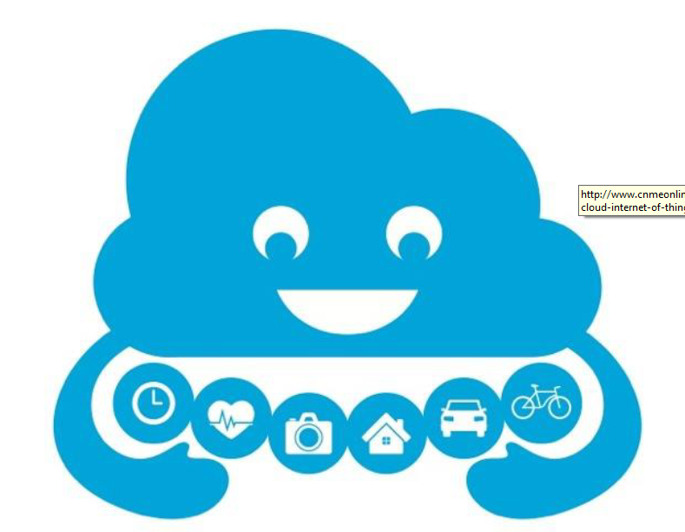
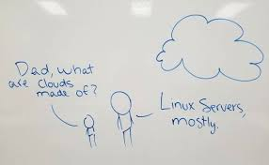
Cloud computing

Slide 13
Now… some of your most likely questions?
How do I get started writing software applications?
What tools and technologies do I need to know?
What patterns and practices should I follow?

Slide 14
Tools that I need
You need to have Notepad.exe – You definitely have notepad in your machine, except if it’s from World War 1
You need to have a way to INTERPRET or COMPILE your code in order to produce result – Browser-based client-side code (HTML, CSS, JavaScript) is interpreted, therefore the browser engine will take care of it when presenting

Slide 15
BUT WHAT IS PROGRAM?
@SEDC 2018-2019

Slide 16
BUT WHAT IS PROGRAM?
A solution to someone's problem
@SEDC 2018-2019

Slide 17

What it is programmers do?
@SEDC 2018-2019

Slide 18
What it is programmers do?
They make programs
@SEDC 2018-2019

Slide 19
Client-side technologies
HTML5 and CSS3 are the buzzwords in software development today
JavaScript is the most relevant scripting/programming language today and it works in both, client-side and server-side (check: Node.js)
Angular.js, React.js, Vue.js are libs and frameworks which if you start learning now, you’ll become most wanted tomorrow.
jQuery is still relevant, although it’s getting replaced by the mentioned ones at #3, as some of these use jQuery under the hood.
@SEDC 2018-2019

Slide 20
Back-end technologies
Development Framework or Back-end Scripting Language
- .NET Framework
- Java
- Node.js
- Other…
-Programming Languages
- C#
- Java
- PHP
- Objective-C
- Other...

Slide 21
Back-end technologies (contd.)
Databases and Storages
Microsoft SQL Server
Oracle
MySQL
PostgreSQL
MongoDB
Memory (as a storage)
Web Servers
IIS
Apache
NGX
@SEDC 2018-2019

Slide 22
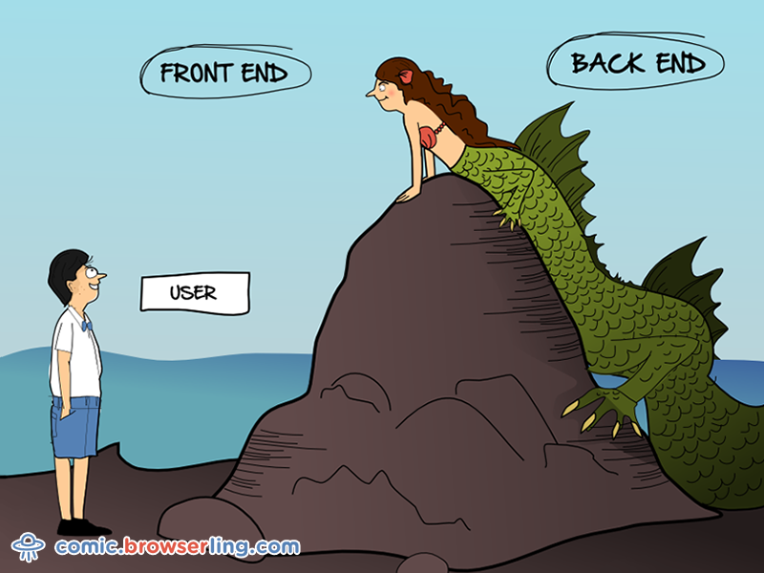
WEB DEVELOPER CATEGORIES
@SEDC 2018-2019

Slide 23
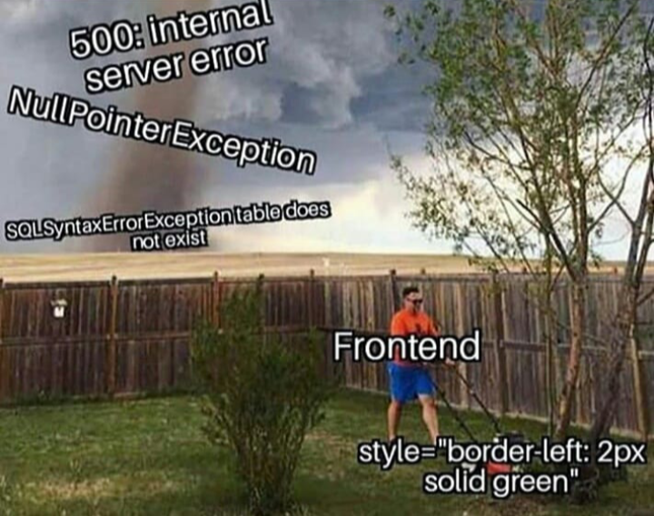
WEB DEVELOPER CATEGORIES
@SEDC 2018-2019

Slide 24
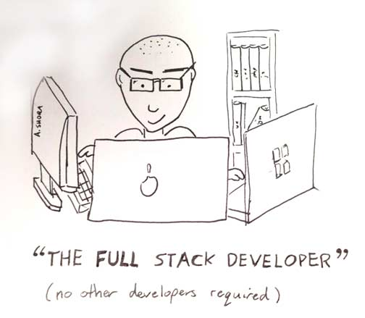
WEB DEVELOPER CATEGORIES
@SEDC 2018-2019

Slide 25
FAQ
Questions you might be asking yourself right now
@SEDC 2018-2019

Slide 26
Programer? Developer? What’s the difference?
@SEDC 2018-2019
Notes:
Programming is writing code
Developing is designing idea to product

Slide 27
Programer? Developer? What’s the difference?
Programmers program. Developers develop.
@SEDC 2018-2019
Notes:
Programming is writing code
Developing is designing idea to product

Slide 28
Should I become a developer?
@SEDC 2018-2019

Slide 29
Should I become a developer?
Yes, if you like solving problems by making programs. Otherwise no.
@SEDC 2018-2019

Slide 30
How do I learn to program?
@SEDC 2018-2019

Slide 31
How do I learn to program?
By programming!
@SEDC 2018-2019

Slide 32
Do I need university education?
@SEDC 2018-2019

Slide 33
Do I need university education?
No.
@SEDC 2018-2019

Slide 34
I get the diploma, and I am done right?
@SEDC 2018-2019

Slide 35
I get the diploma, and I am done right?
No.
@SEDC 2018-2019

Slide 36
What language should I use?
@SEDC 2018-2019

Slide 37
What language should I use?
“Programmers who program "into" a language first decide what thoughts they want to express, and then they determine how to express those thoughts using the tools provided by their specific language.”
― Steve McConnell, Code Complete
@SEDC 2018-2019

Slide 38
Are there blogs or newsletters I can follow?
Hacker news
Joel on software
Coding horror
Fabulous adventures in coding
Programmer's digest
dev.to
@SEDC 2018-2019

Slide 39
What books should I read?
The pragmatic programmer
Code complete
Clean Code
Head-first Design patterns
Secrets of the JavaScript Ninja
C# In Depth
@SEDC 2018-2019

Slide 40
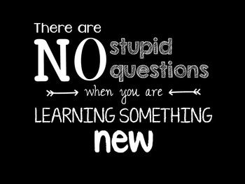
But how do I…?
@SEDC 2018-2019

Slide 41
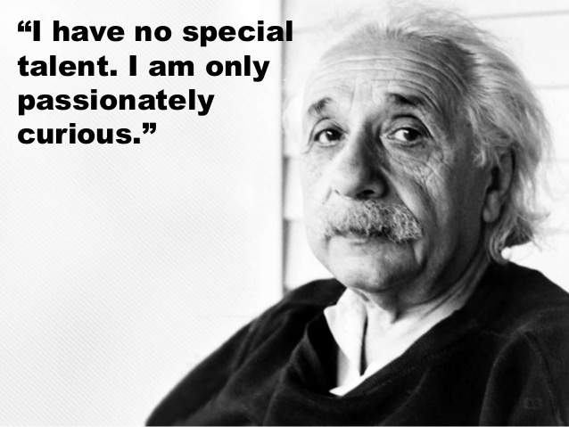

Slide 42

Q&A section
@SEDC 2018-2019

